Slide 1
SUPER-MARKET SALES ANALYSIS DASHBOARD
Presented By: Bhaskar V Pawar

Slide 2
AGENDA
Objective of the Project
Dataset Overview
Data Cleaning &Transformation
Reports & Dashboards
Key Insights
Suggestions & Conclusions

Slide 3
OBJECTIVE
To provide key insights on the sales
To provide No. of orders, Total sales, Average no. of shipping days
To create an easy-to-understand analysis
To create an insightful interactive dashboard

Slide 4
DATASET OVERVIEW
Table used: SuperMarket Data
Category
City
Country
Order Date
Profit
Sales
Ship Date
Region

Slide 5
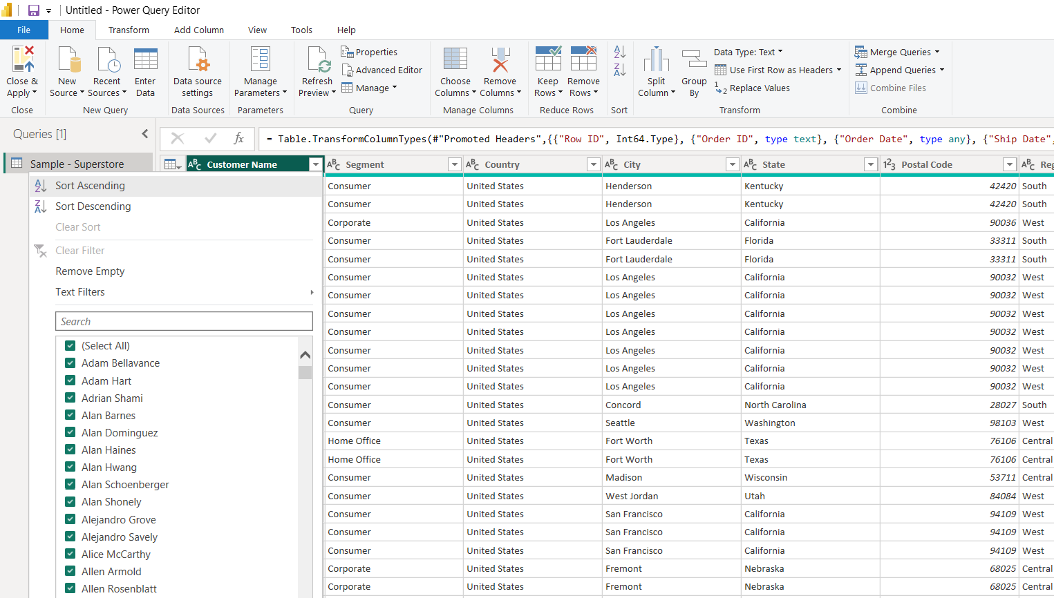
DATA CLEANING AND TRANSFORMATION
Removed null values from:
Row ID
Order ID

Slide 6
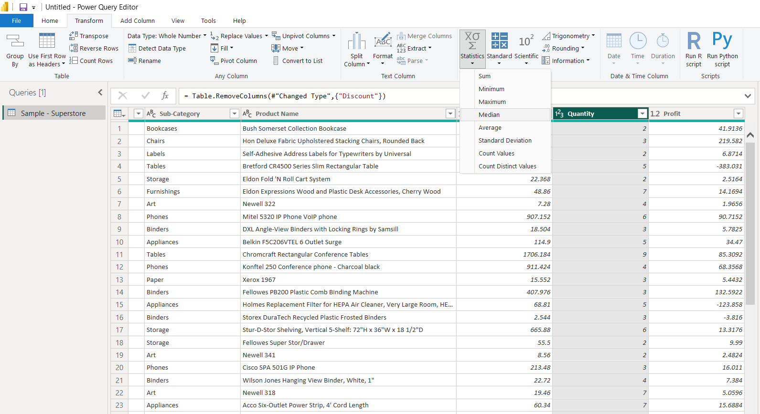
DATA CLEANING AND TRANSFORMATION
Removed missing values from:
Quantity column

Slide 7
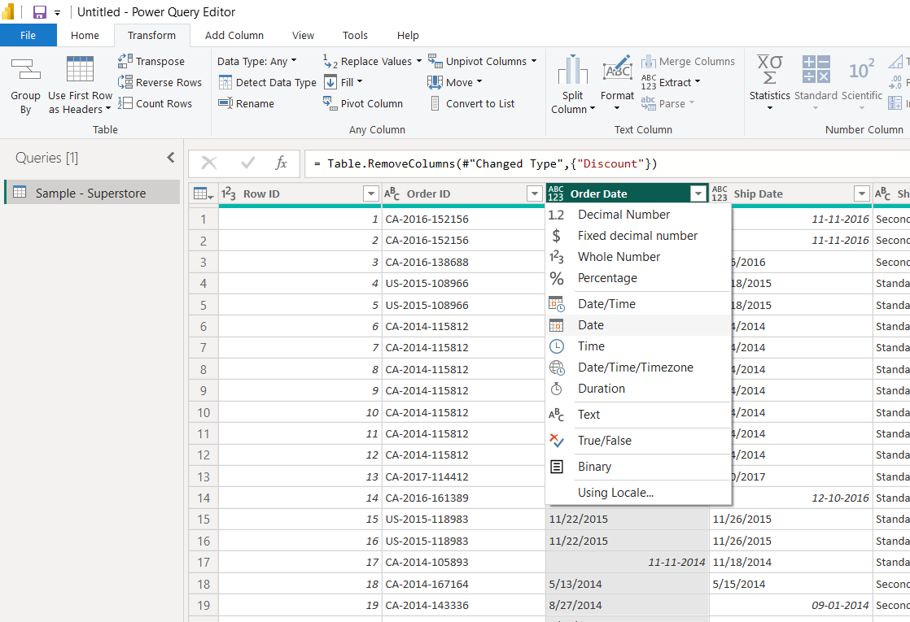
DATA CLEANING AND TRANSFORMATION
Converted from text to date:
Order Date
Ship Date

Slide 8
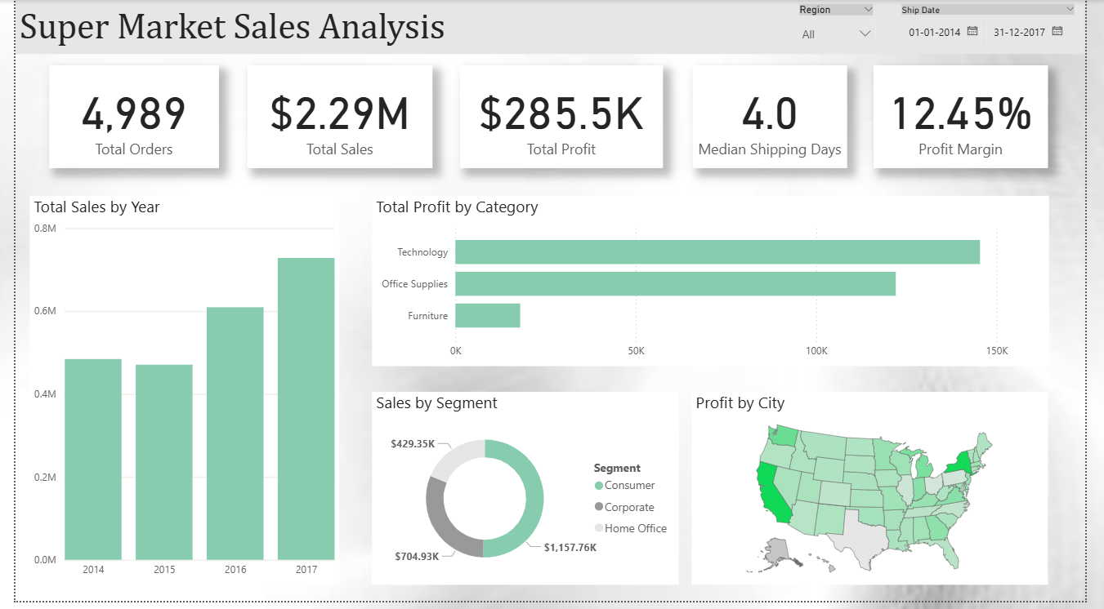
REPORTS AND DASHBOARDS

Slide 9
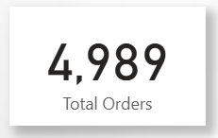
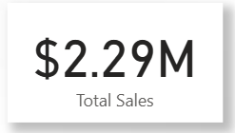
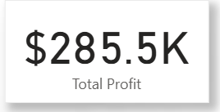
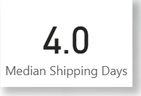
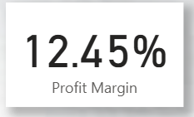
CARDS FOR KEY INSIGHTS
Total Orders: Displays orders by customers
Total Sales: Displays overall sales of the supermarket
Total Profit: Displays overall profit
Median Shipping Days: Median of shipping days
Profit Margin: Displays profit in percentage

Slide 10
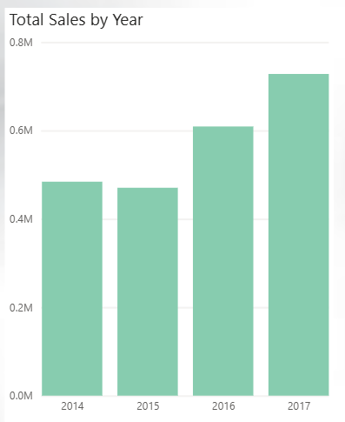
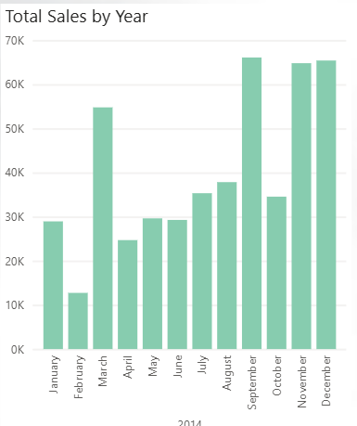
VISUALS INCLUDED
Clustered column chart:
To analyse total sales by year
With drill down option for months

Slide 11
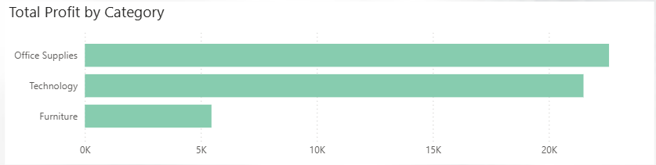
VISUALS INCLUDED
Clustered bar chart:
For Total Profit by Category

Slide 12
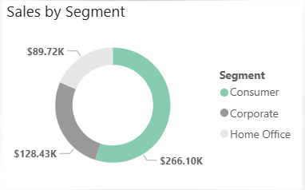
VISUALS INCLUDED
Donut Chart:
To analyse Sales by Segment

Slide 13
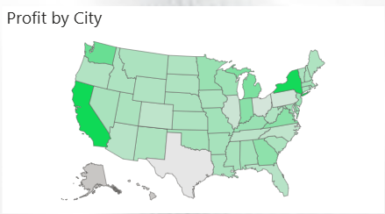
VISUALS INCLUDED
Shape map:
To learn about the profit by each city

Slide 14


INTERACTIVITY FEATURES
Time Filter:
Provides the range between years
Drop-down Slicer:
To select specific region

Slide 15
SUGGESTIONS
Texas and Alaska needs focus to boost sales
Furniture Category needs to be highly marketed
Provide more discounts to Consumer Segment

Slide 16
CONCLUSION
Sales has been growing yearly
Profit Margin is good
California has the most customers
Customers are more inclined towards products under Technology

Slide 17
THANK YOU

